Slide 1
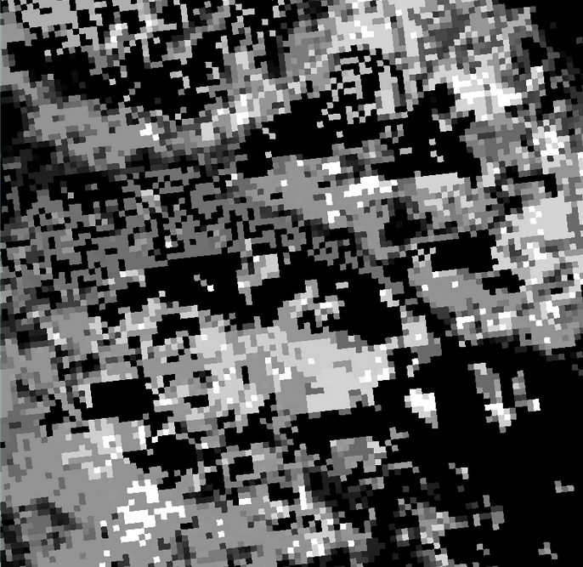
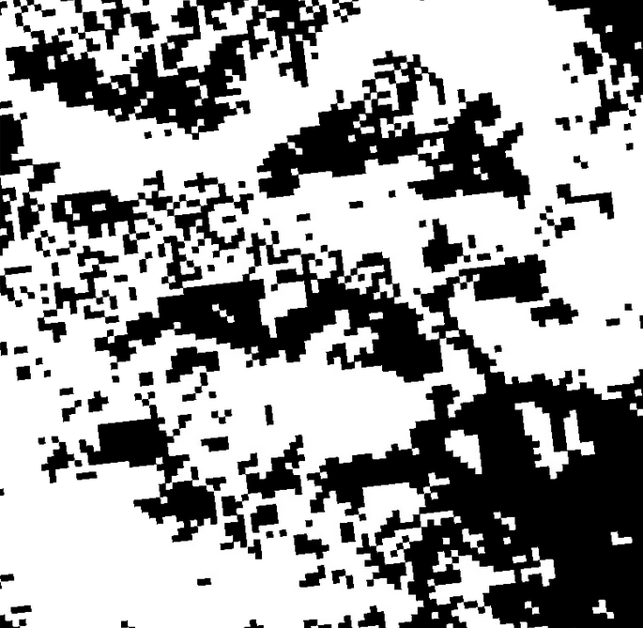
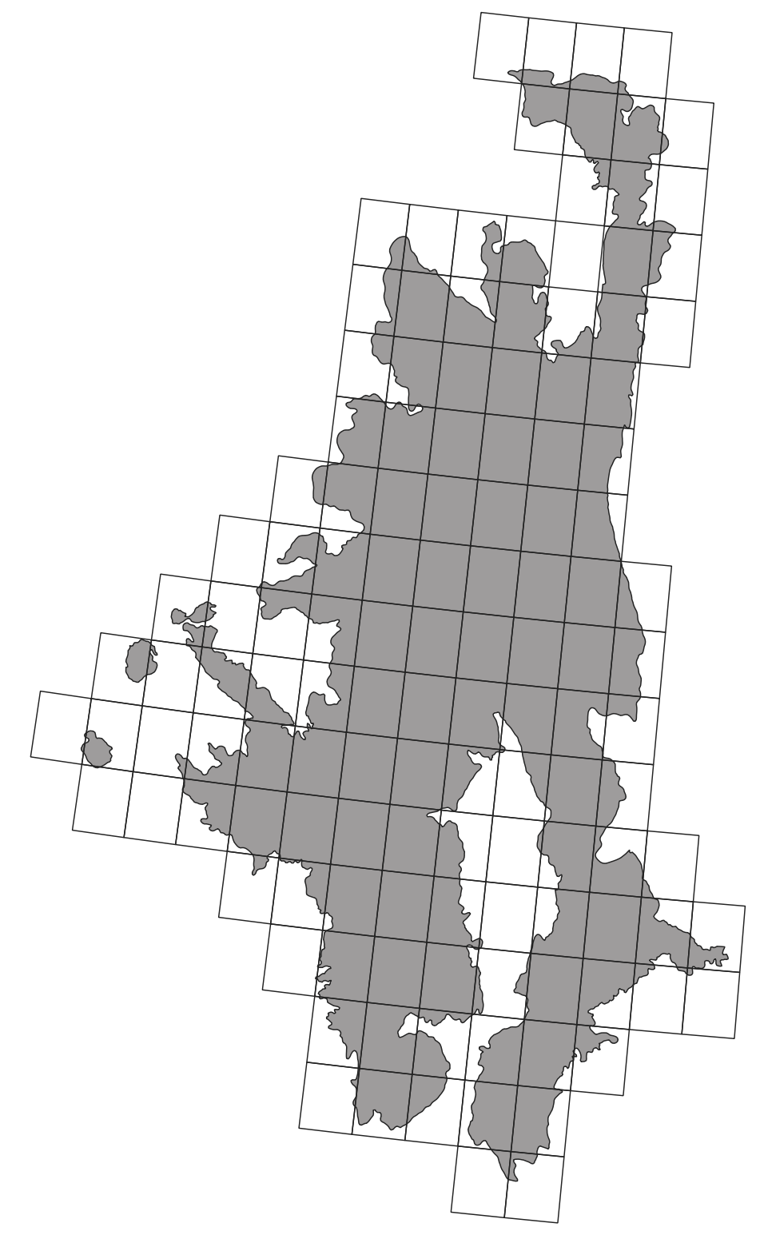
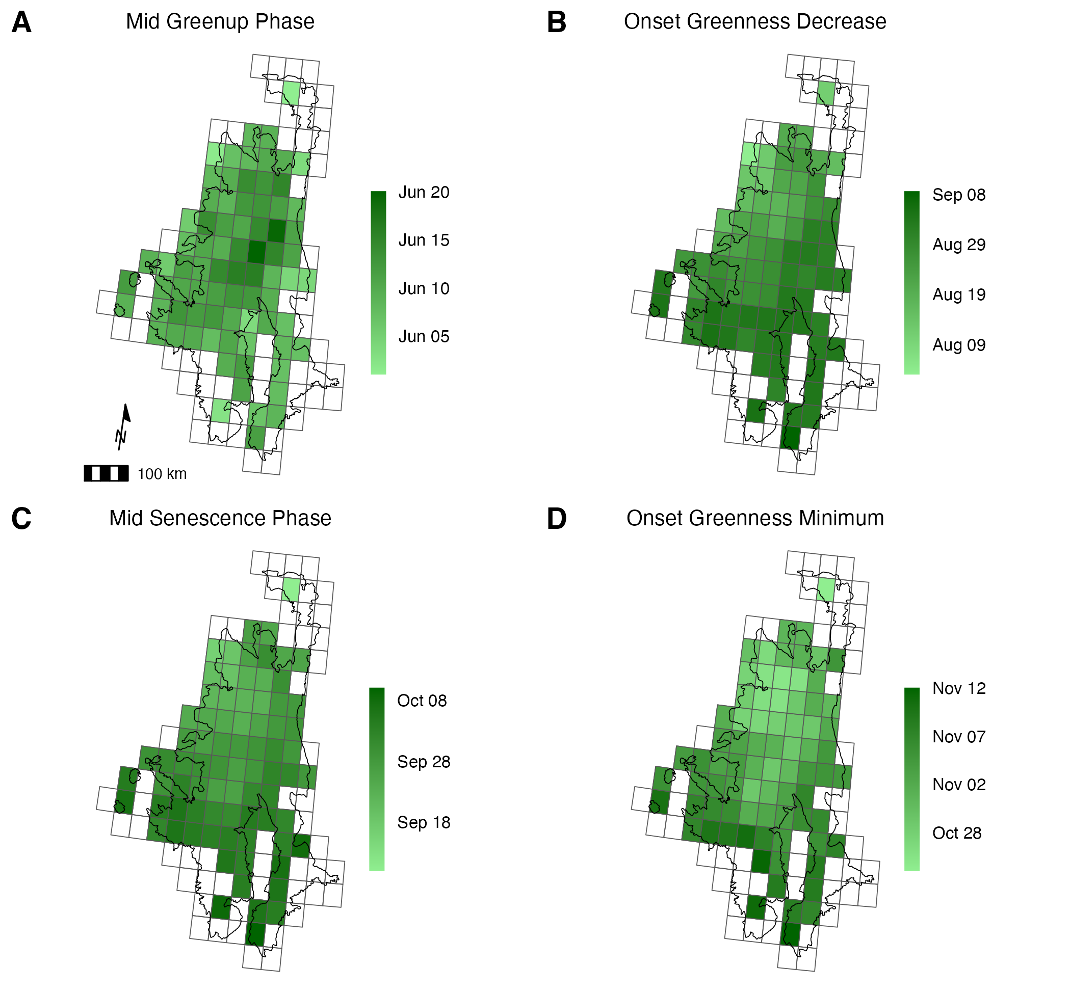
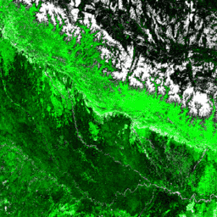
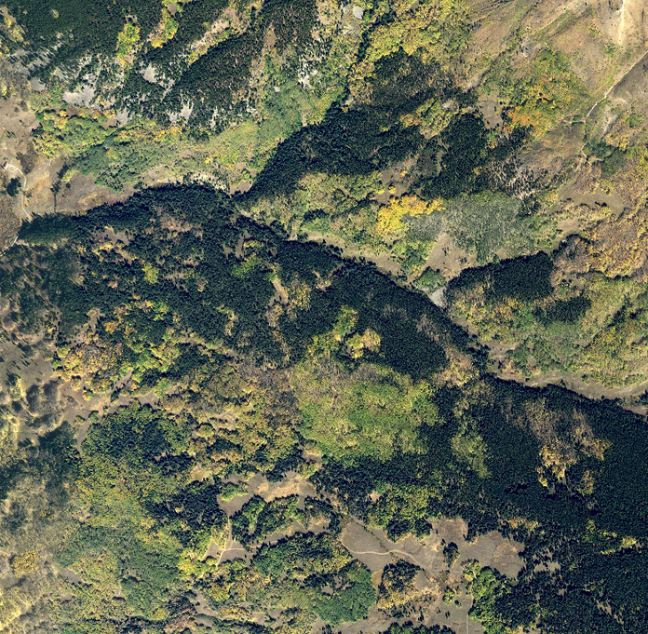
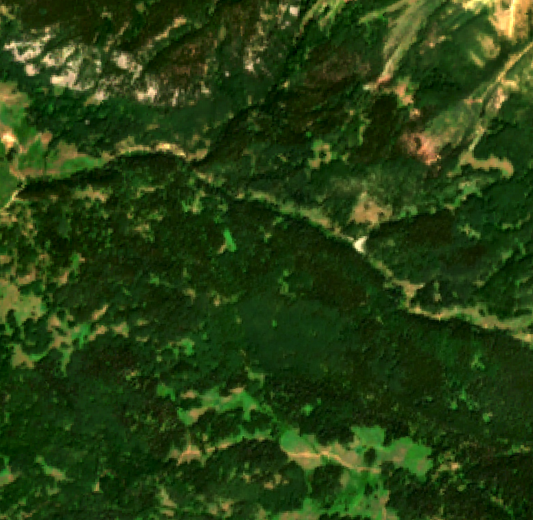
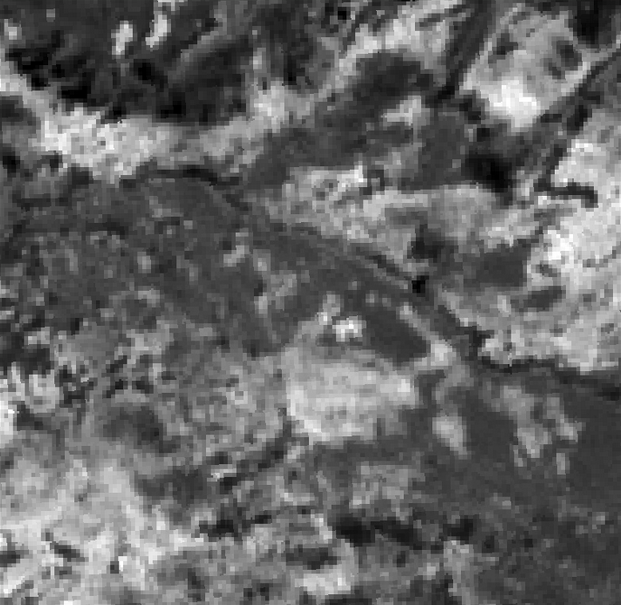
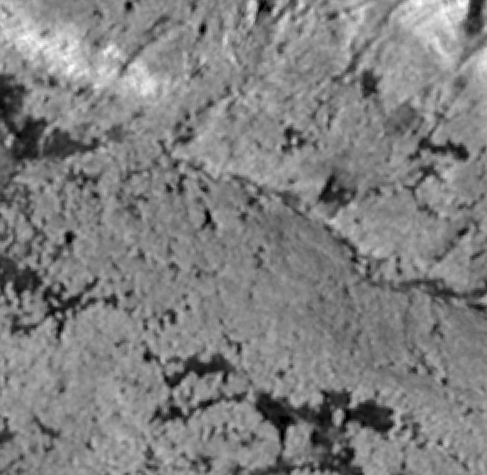
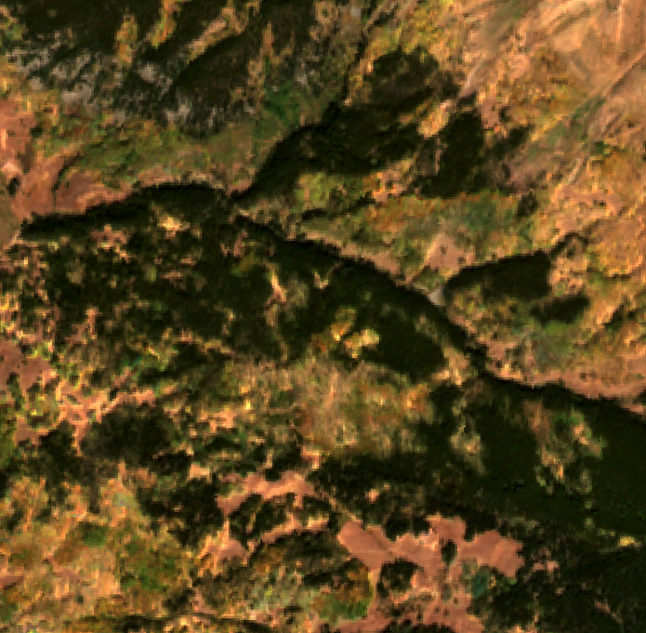
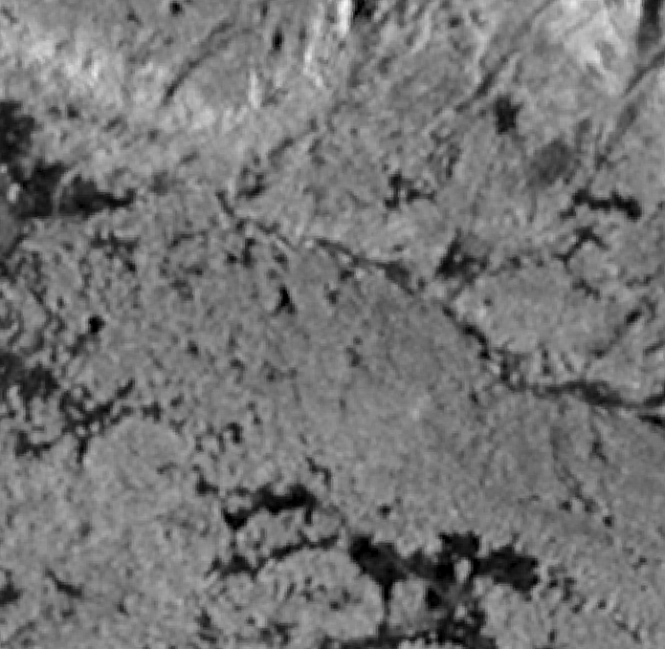
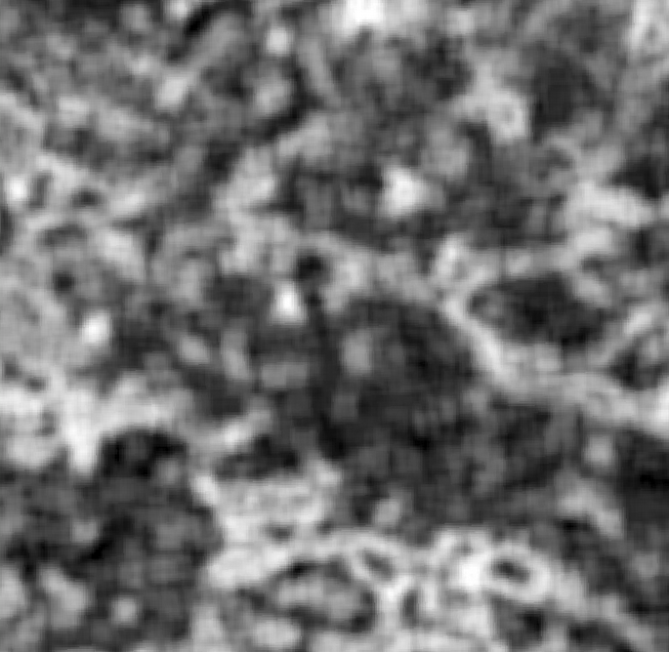
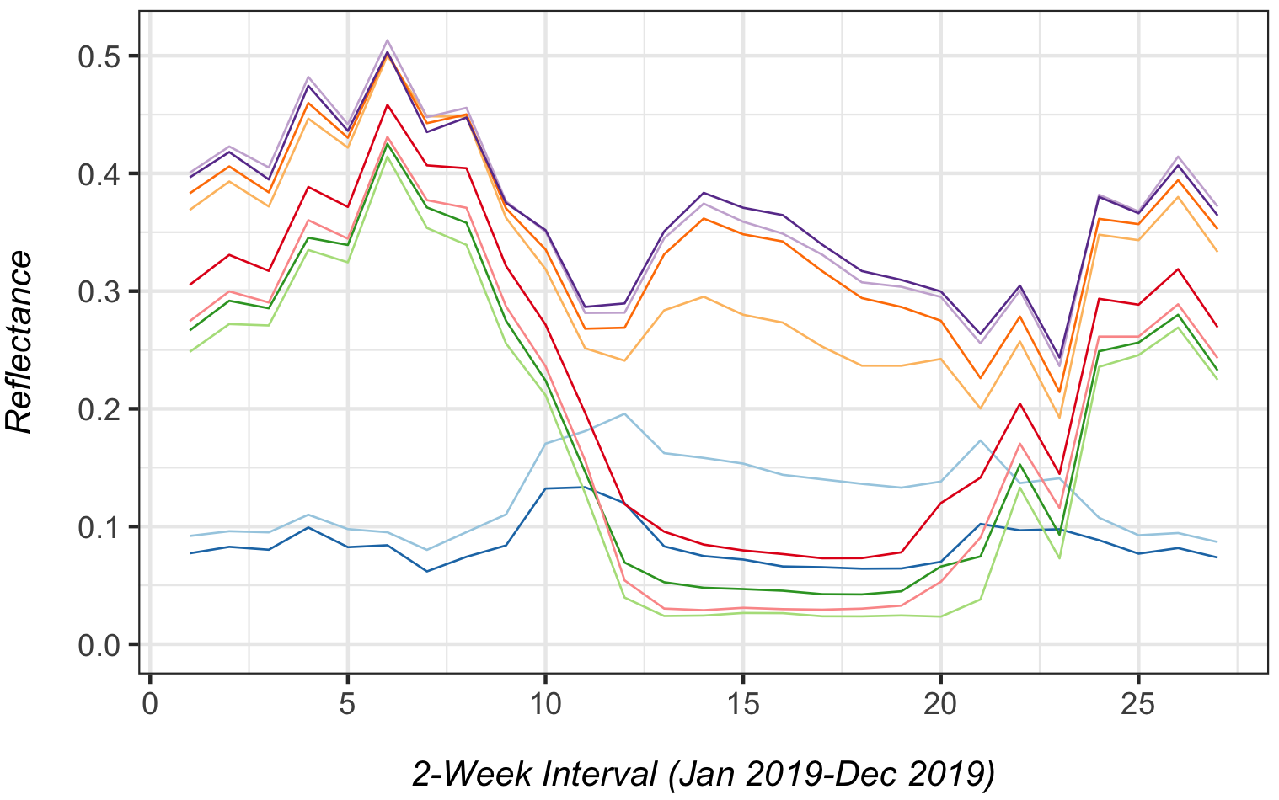
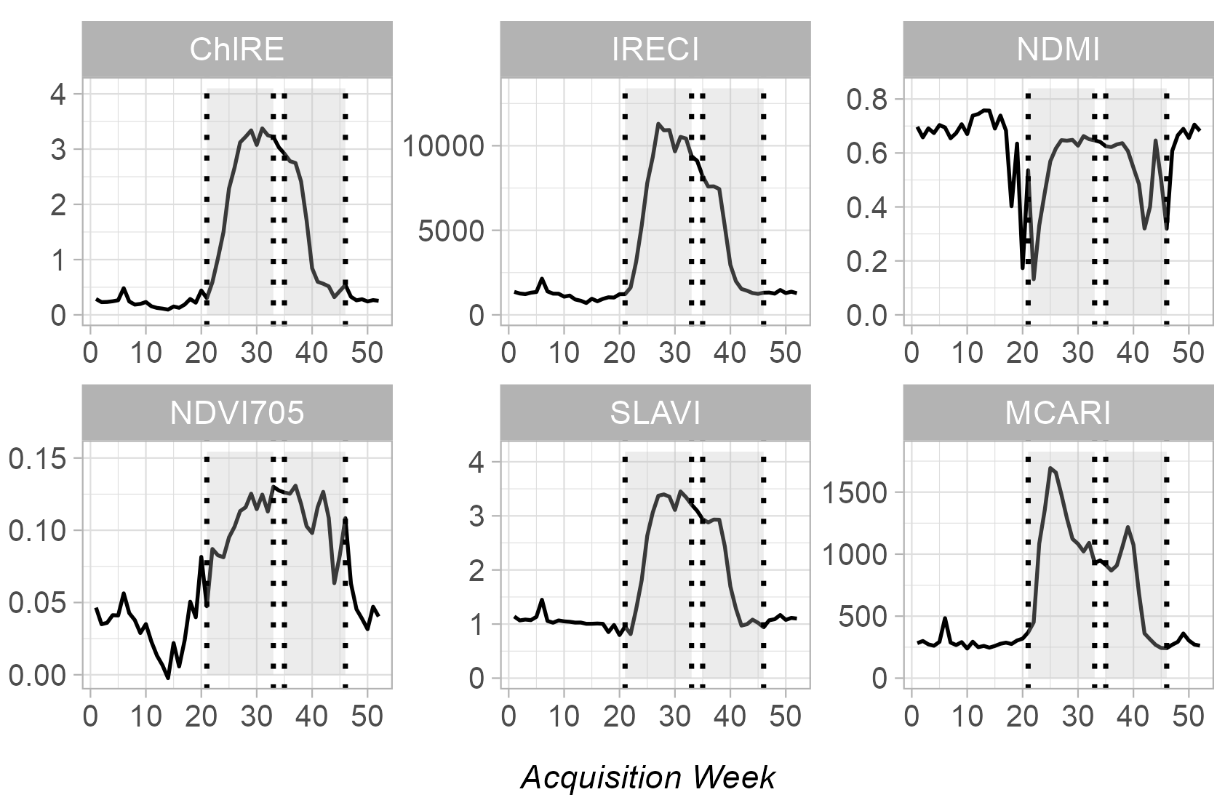
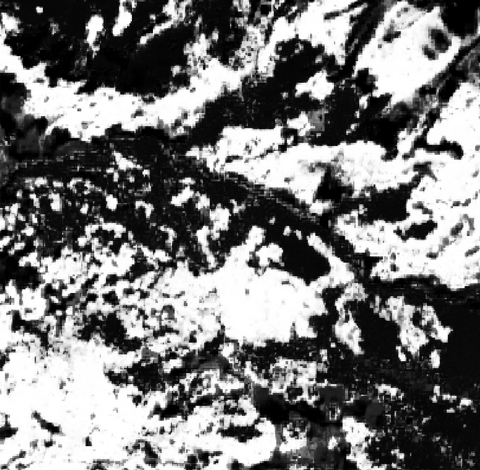
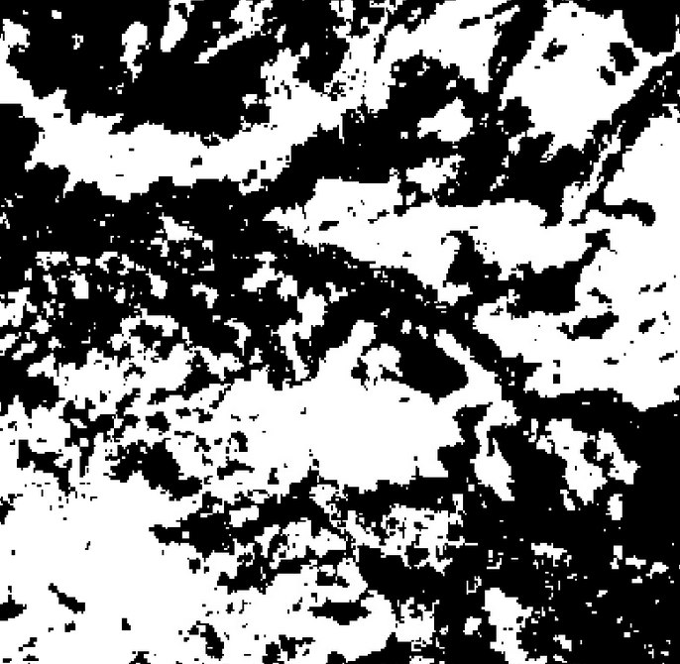
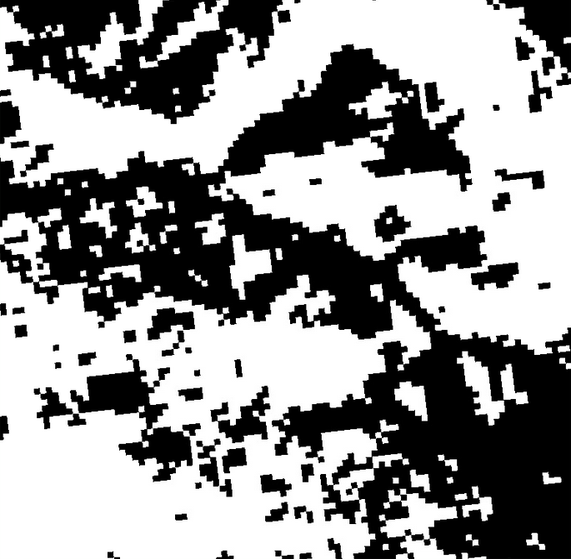
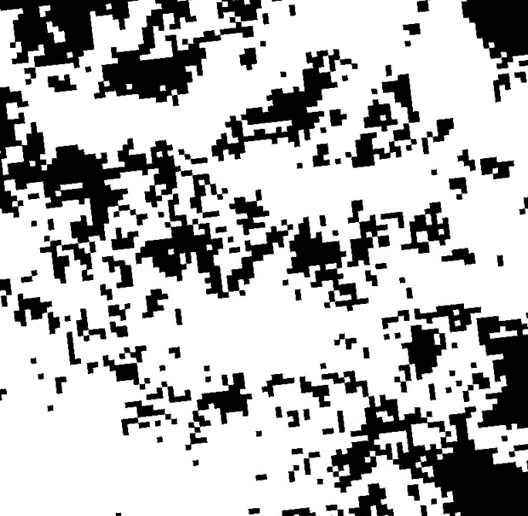
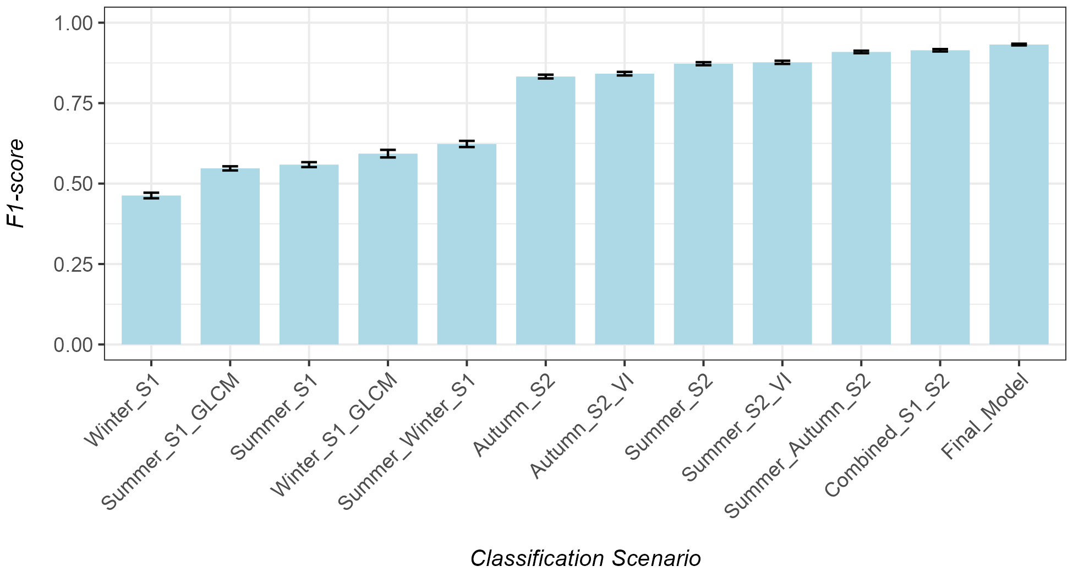
Create the Initial Aspen Forest Mask
USFS TreeMap (ca. 2016) Live Basal Area
Live Basal Area > 10 stems/ha
Phenology
VIIRS Land Surface Phenology (VNP22Q2 )
Aspen Reference Data
NAIP (ca. 2017)
Summarize within spatial blocks / aspen mask
5km
Median seasonal composites (S1 and S2)
Sentinel-1 Time-series
Sentinel-2 Time-series
Additional border noise correction and speckle filtering
Combine orbital passes for both polarizations
Slice to winter (dormancy) and summer (peak greenness)
Slice S2 time-series to summer and autumn based on aspen phenology
Mask occluded pixels with Cloud Score + (> 0.60)
S1 Time-series
S2 Time-series
Spectral Indices
GLCM Texture
S2 Summer/Autumn
S1 Summer/Winter
Scenario testing and feature selection
Image Classification
Agreement with existing products
Probability
Distribution
LANDFIRE EVT
USFS ITSP
USFS TreeMap

Slide 2
1. Creating Presence and Background Reference Data
Create Initial Aspen Forest Mask
Aspen Reference Data (Presence)
Background Reference Data
USFS TreeMap Live Basal Area (BA)
Reclassify where aspen BA > 10 stems/ha
Aerial Imagery
Photo interpretation of aspen stands
LANDFIRE EVT outside of aspen mask
Stratified random sample of EVT Sub-class by spatial block
Create random points within spatial blocks
Buffer points by 5km for aerial support
Presence and Background Reference Data
2. Creating the Sentinel-1 and Sentinel-2 Seasonal Composites
Sentinel-2 Data
Calculate median phenology in aspen mask
Generate the seasonal median spectral composites
Annual spectral response of aspen ref. data
S2 Median Summer Composite
VIIRS Land Surface Phenology (VNP22Q2)
Calculate median day-of-year phenology metrics by spatial block
Sentinel-2 (S2) time-series
Calculate spectral indices
Cloud-masking
Temporal filters
S2 Median Autumn Composite
Sentinel-1 Data
Generate the seasonal median radar composites
S1 Median Summer Composite
Sentinel-1 (S1) time-series
Additional border noise correction
Combined ascending / descending tracks
Temporal filters
Calculate radar textural features (GLCM)
Analysis-ready S1
S1 Median Winter Composite
Multi-temporal speckle filtering
3. Random Forest (RF) modelling incl. scenario testing and accuracy assessment
4. Agreement with Existing Products
Run scenario testing
Best-performing classification scenario
Sentinel-based aspen probability map
Combined S1/S2 + topography image stack
Sentinel-based
Agreement with validation data and pixel-based
Precision, Recall, F1-Score
Feature selection
Threshold testing
Landfire EVT
RF for classification scenarios
Confusion Matrix
Final RF model
USFS TreeMap
Landscape patch analysis
Reclassified Sentinel-based aspen map
USFS ITSP

